Slide 1
CSE4255: Telecommunication Lecture 2
Telephone Network

Slide 2
Public Switched Telephone Network
The public switched telephone network (PSTN), also known as Plain Old Telephone System (POTS), had its beginnings in the late 1800s.
It was originally an analog system using analog signals to transmit voice.
With the advent of the computer era, the network, in the 1980s, began to carry data in addition to voice using dial-up lines or dedicated lines.
It is full duplex and use circuit switch network to transmit human voice.

Slide 3
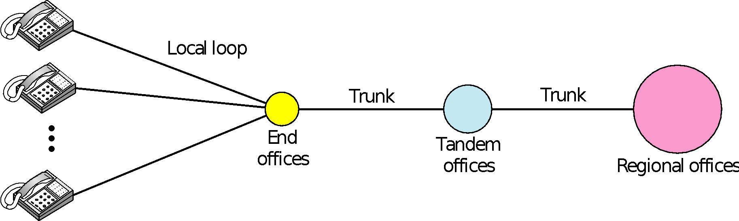
Components of a Telephone System
Trunk: Transmission media that handle communication between office. Transmission is usually through optical fiber or satellite.
Twisted-pair cable that connects subscriber telephone to nearest end office or local central office. When used for voice, has a BW 4 kHz.
Notes:
The first three digits of a local telephone number define the office, and the next four digits define the local loop number.

Slide 4
LATAs
Local Access Transport Area.
A LATA is a geographical area where a local telephone company may carry both local calls and toll calls.
A small area may have one single LATA; a large area may have several LATAs.
There are two types of services:
Intra-LATA services
Inter-LATA services

Slide 5
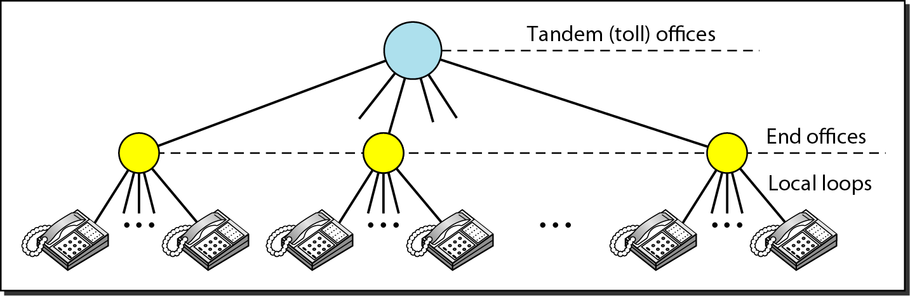
Intra-LATA Services
The services offered by the common carriers (telephone companies) inside a LATA are called intra-LATA services.
The carrier that handles these services is called a local exchange carrier (LEC).
Communication inside a LATA is handled by end switches and tandem switches.
A call that can be completed by using only end offices is considered toll-free.
A call that has to go through a tandem office is charged.

Slide 6
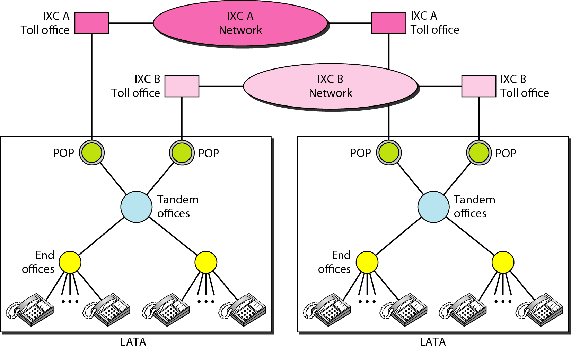
Inter-LATA Services
The services between LATAs are handled by interexchange carriers (IXCs).
These carriers, some times called long-distance companies, provide communication services between two customers in different LATAs.

Slide 7
Points of Presence (POP)
A point of presence is a switching office within a LATA.
Each IXC that wants to provide inter-LATA services in a LATA must have a POP in that LATA.
The LECs that provide services inside the LATA must provide connections so that every subscriber can have access to all POPs.
Making a Connection
A subscriber who needs to make a connection with another subscriber is connected first to an end switch and then, either directly or through a tandem switch, to a POP.
The call now goes from the POP of an IXC (the one the subscriber has chosen) in the source LATA to the POP of the same IXC in the destination LATA.
The call is passed through the toll office of the IXC and is carried through the network provided by the IXC.

Slide 8
Signalling
Signaling is the extra electrical information other than the traffic.
It refers to the exchange of information between call components required to provide and maintain service.
There are 2 types of signaling:
In in-band signaling, the same circuit is used for both signaling and voice.
In out-of band signaling, a portion of the bandwidth is used for signaling and another portion for voice.

Slide 9
Signalling Functions
The signaling system perform the following tasks such as:
1. Providing dial tone, ring tone, and busy tone
2. Transferring telephone numbers between offices
3. Maintaining and monitoring the call
4. Keeping billing information
5. Maintaining and monitoring the status of the telephone network equipment
6. Providing other functions such as caller ID, voice mail, and so on

Slide 10
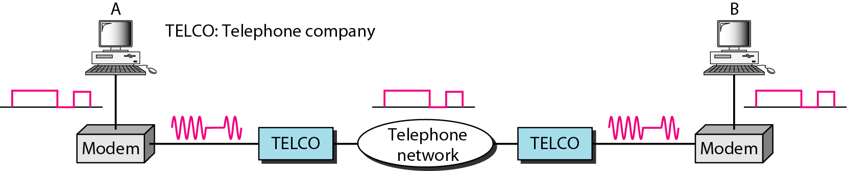
DIAL-UP MODEMS
Data transfer using the telephone local loop was traditionally done using a dial-up modem.
The term modem is a composite word that refers to the two functional entities that make up the device: a signal modulator and a signal demodulator.

Slide 11
DSL
Telephone companies developed another technology, digital subscriber line (DSL), to provide higher-speed access to the Internet.
It is one of the most promising for supporting high-speed digital communication over the existing local loops.
DSL technology is a set of technologies, each differing in the first letter
ADSL
VDSL,
HDSL
SDSL

Slide 12
ADSL
Asymmetric Digital Subscriber Line
It provides higher speed (bit rate) in the downstream direction (from the Internet to the resident) than in the upstream direction (from the resident to the Internet).
ADSL is an asymmetric communication technology designed for residential users; it is not suitable for businesses.
It uses the existing local loops and can handle bandwidths up to 1.1 MHz.
ADSL is an adaptive technology. The system uses a data rate based on the condition of the local loop line.

Slide 13
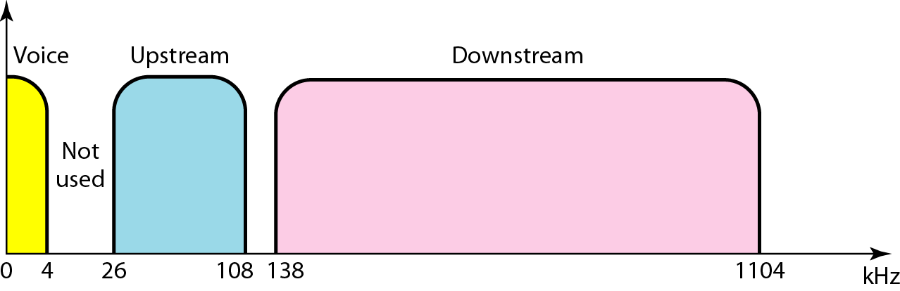
Bandwidth division in ADSL
Transmission: twisted-pair (1 pair)
Divides 1.104 MHz bandwidth into three bands (256 channels; 4.312 KHz per channel)
POT (voice) (channel 0)
Idle. Channels 1 to 5 are not used and provide a gap between voice and data communication.
Upstream (channel 6-30; 25 channels),
Downstream (channel 31-255; 225 channels)

Slide 14
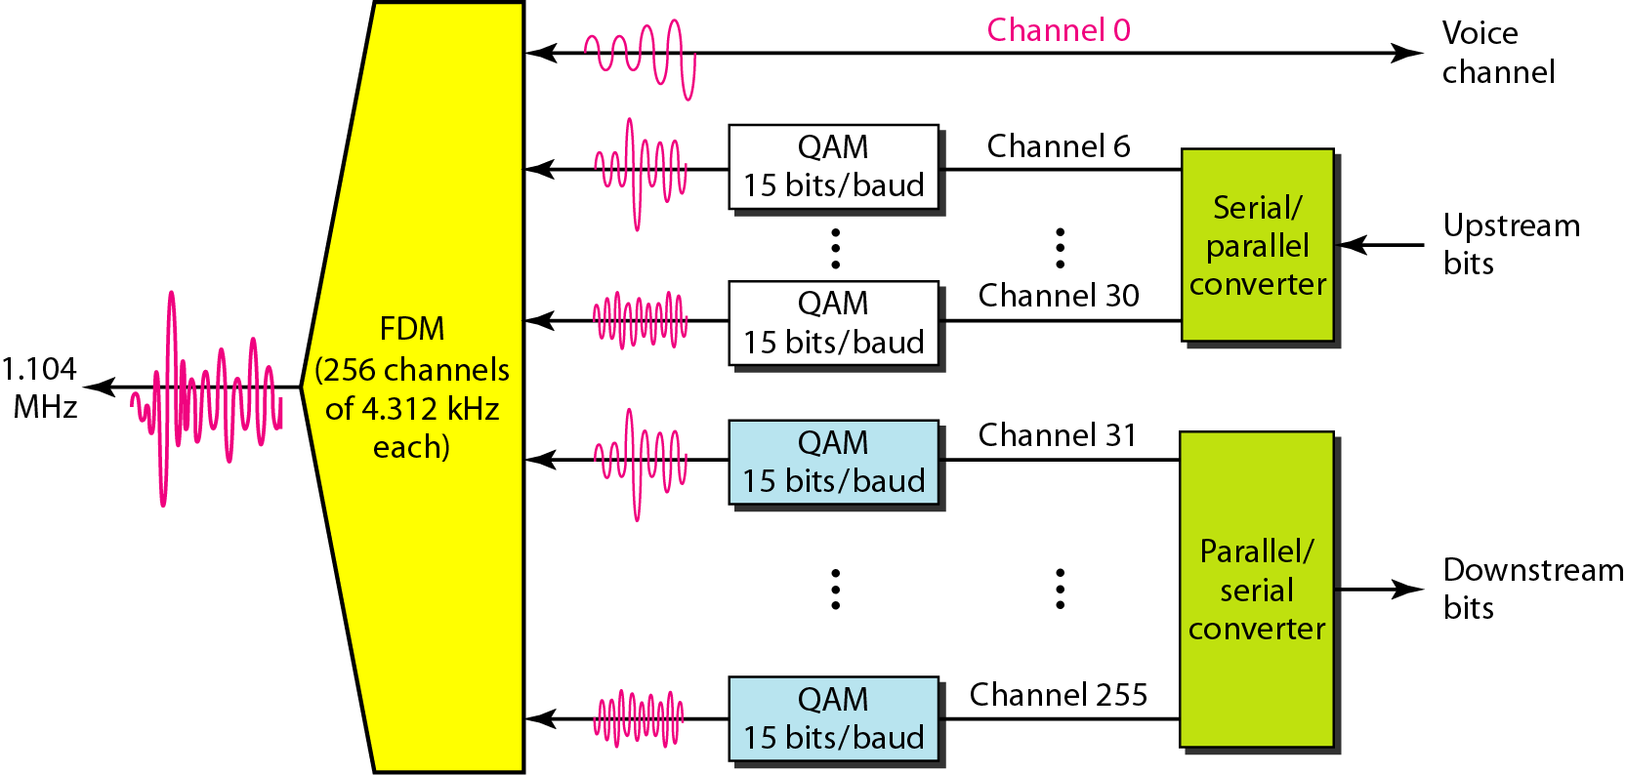
Discrete Multitone Technique (DMT) : Modulation technique standard for ADSL which combines QAM and FDM.
1 control channel
24 data transfer
1 control channel
224 data transfer
~ 4 KHz / channel
60 Kbps/ channel
Notes:
If there are 24 channels, each using 4 kHz (out of 4.312 kHz available) with QAM modulation, we have 24 x 4000 x 15, or a 1.44-Mbps bandwidth, in
the upstream direction.
If there are 224 channels, we can achieve up to 224 x 4000 x 15, or 13.4 Mbps in downstream direction.

Slide 15
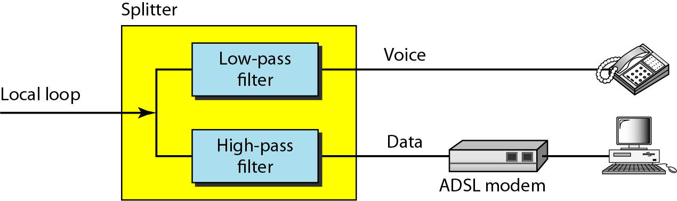
ADSL modem: Customer Site

Slide 16
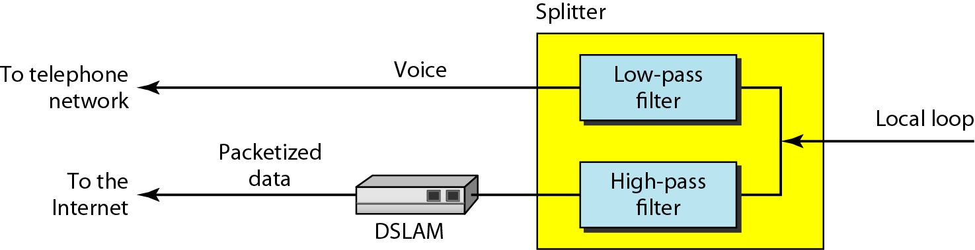
ADSL modem: Telephone company Site

